Slide 1

Amazon Product Reviews
1

Slide 2
Amazon Product Reviews
1

Slide 3
Amazon Product Reviews
1
OFFICE PRODUCTS
CDs Vinyl
Web App

Slide 4
Amazon Product Reviews
Office Products
CDs Vinyl
1
Web App

Slide 5

TEAM INTRODUCTION

Slide 6





TEAM INTRODUCTION
Shivansh Bhardwaj
Nikhilesh Paliwal
Karthik Nangunuri
Deepak Kumar
Bijnor, Uttar Pradesh
NIIT
Bhardwajshivansh95@gmail.com
Ludhiana, Punjab
NIIT
paliwalnikhilesh29@gmail.com
Warangal, Telangana
NIIT
karthiknangunuri1045@gmail.com
Patna , Bihar
NIIT
deepakkr11997@gmail.com
3

Slide 7
TABLE OF CONTENT

Slide 8
2
TABLE OF CONTENT
Project Objective
Challenges faced and Approch
Problem Solution
Business Conclusion
Over View of Dataset
Sentiment Analysis
Time series Analysis
Sentiment Forecast
Classification Model
Web App on Sentiment Analysis and Product recommender

Slide 9
TEAM INTRODUCTION
Objective
Many customers tend to read product reviews before buying something, and research indicates that positive reviews play a crucial role in their decision-making process.
In other words, a significant number of people rely on feedback from other customers who have already used the product to assess its quality and make a purchase.
The conventional way of handling Amazon product reviews, which involves manually sorting through millions of reviews, is not only slow and inefficient but also fails to reveal any meaningful patterns or trends over time.
As a result, a more effective and efficient approach is needed to analyze and understand the sentiment of customers towards products
Difficult to analyze the Brands who’s getting negative reviews from large set of data
Also, Difficult to analyze for the Business Holders to interpret regarding the business growth .
4

Slide 10
Problem Solution & Overview
We are leveraging sentiment analysis techniques to analyze product reviews and accurately forecast ratings based on customers' sentiments towards the products, thereby providing a professional approach to understanding customer feedback.
We Created a Web Application to help customers and Business Holders in Sentiment Analysis on Review’s
We have created a web application that helps customers by providing them with recommended products
Sentiment Analysis:
Use Natural Language Processing (NLP) techniques to perform sentiment analysis on the reviews.
Clean the raw data by removing special characters, and unwanted symbols. Tokenize the text into individual words and remove stop words
Determine the overall sentiment (positive, negative, neutral) of each review.
2.Clustering:
Group the reviews into clusters based on the topics discussed.
Utilize unsupervised learning algorithms such as K-means to cluster the reviews.
Use visualization techniques to identify the cluster.
5

Slide 11
Problem Solution & Overview
We are leveraging sentiment analysis techniques to analyze product reviews and accurately forecast ratings based on customers' sentiments towards the products, thereby providing a professional approach to understanding customer feedback.
We Created a Web Application to help customers and Business Holders in Sentiment Analysis on Review’s
We have created a web application that helps customers by providing them with recommended products
3.Time Series Analysis
Analyze the trend of reviews over time.
Utilize time-series analysis techniques such as SARIMA, Exponential Smoothing.
Use visualization techniques to plot the trends and make predictions.
Classification
Use supervised learning algorithms such as Logistic Regression, Naive Bayes, or Random Forest to classify reviews as positive, negative, or neutral.
Use labeled data to train the model and predict from the model
Evaluate the model using accuracy, precision, recall, and F1-score metrics.
6

Slide 12


Overview of Datasets
Dataset Features
For our analysis, we have chosen the categories of ‘Office Products’ and ‘CDs Vinyl’.
FEATURE NAME | DESCRIPTION
1. ASIN | ID of the product
2. Title | Name of the product
3. Price | Price in US dollars (at time of crawl)
4. Brand | Brand name
5. ReviewTime | Particular review submitted Time
6. ReviewerID | ID of the reviewer
7. Vote | No of Votes per Review
8. ReviewText | Text of the review
9. Overall (Ratings) | Rating of the product
10. Date | Time of the review
Dataset Name ( Categories ) | File Type
Office Products | Code Book - EDA -
CDs Vinyl | Code Book - EDA -
11. Reviewer Name | Name of the Reviewer
12. Summary | Summary of the Review
13. Category | List of category the product belongs to
7

Slide 13
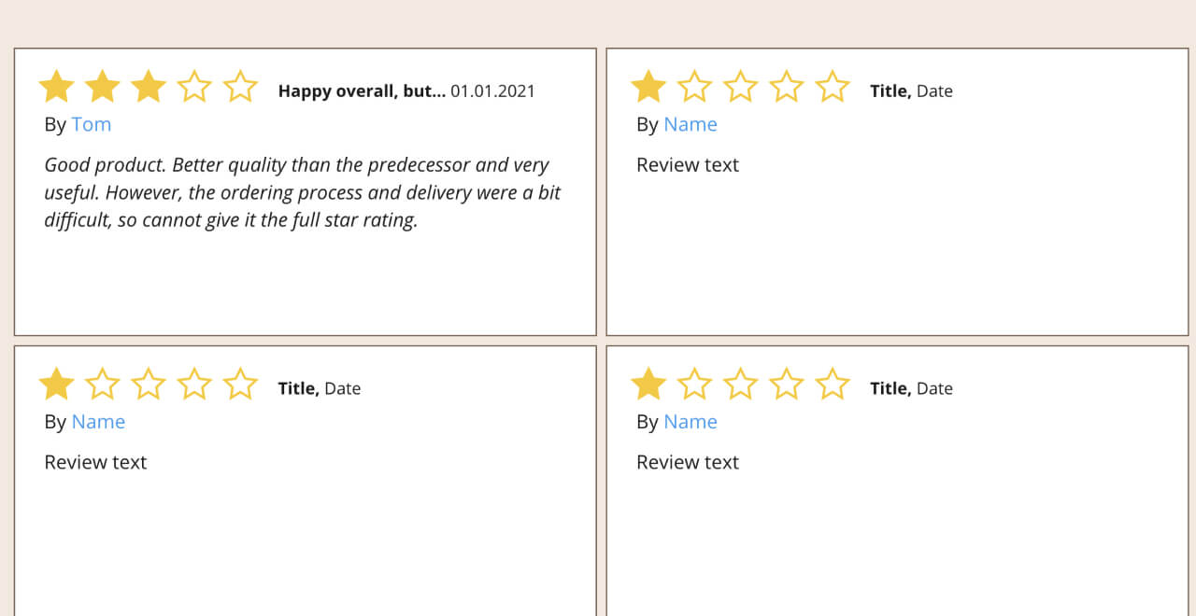
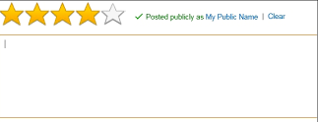
Why Sentiment Analysis?
Negative product review
Absolute waste of money, will be sending it back ASAP!
Sentiment analysis is a powerful tool in natural language processing (NLP) that enables us to extract and analyze the emotions and opinions expressed in text data. Sentiment analysis is crucial in understanding the attitudes and opinions of customers towards products or services
Positive:
Good quality product,I highly recommend!
BUSINESS RELEVANCE
Neutral:
The service was alright. Not bad, not great.
Improve product quality
Improve customer service
Reputation management
Identify customer preferences
8

Slide 14
Why Sentiment Analysis?
Positive:
Good quality product,I highly recommend!
Sentiment analysis is a powerful tool in natural language processing (NLP) that enables us to extract and analyze the emotions and opinions expressed in text data. Sentiment analysis is crucial in understanding the attitudes and opinions of customers towards products or services
Neutral:
The service was alright. Not bad, not great.
Negative product review
Absolute waste of money, will be sending it back ASAP!
BUSINESS RELEVANCE
Improve product quality
Improve customer service
Reputation management
Identify customer preferences
8

Slide 15
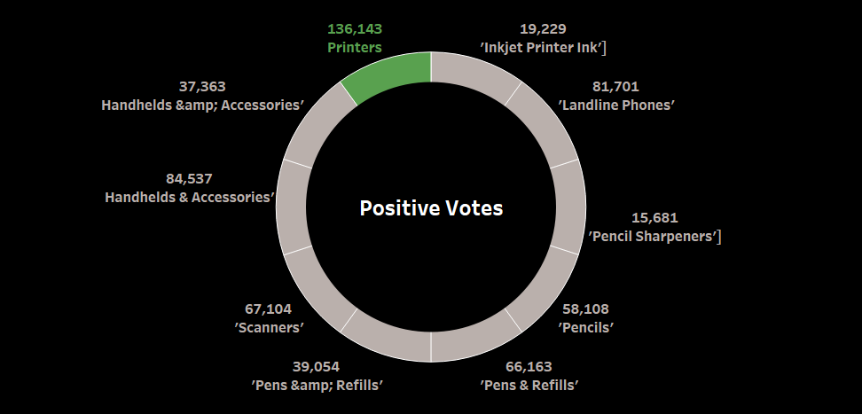
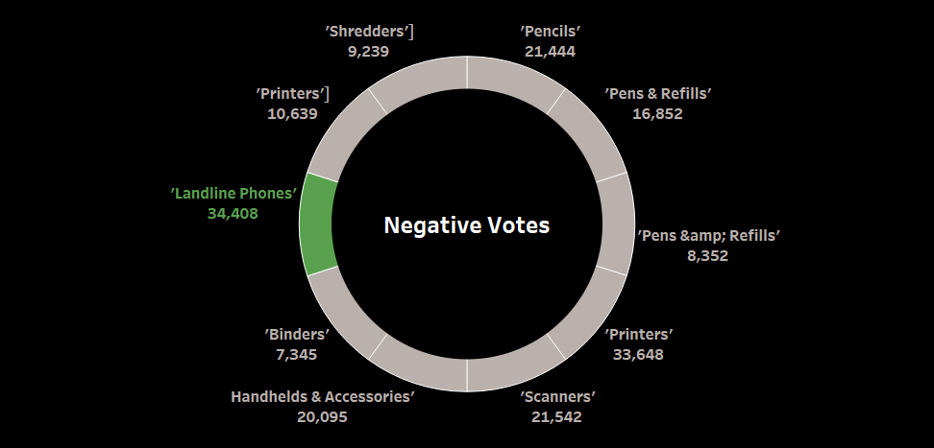
OFFICE PRODUCT – Subcategory wise Positive and Negative Votes
9

Slide 16
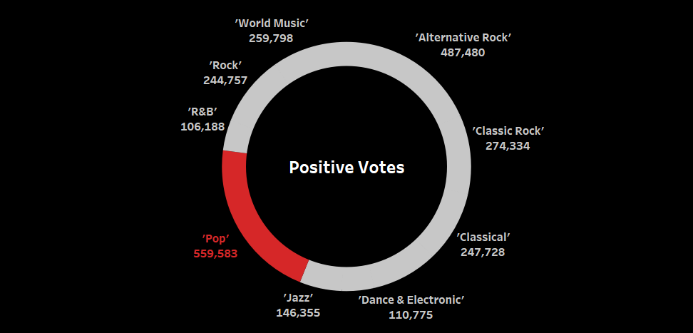
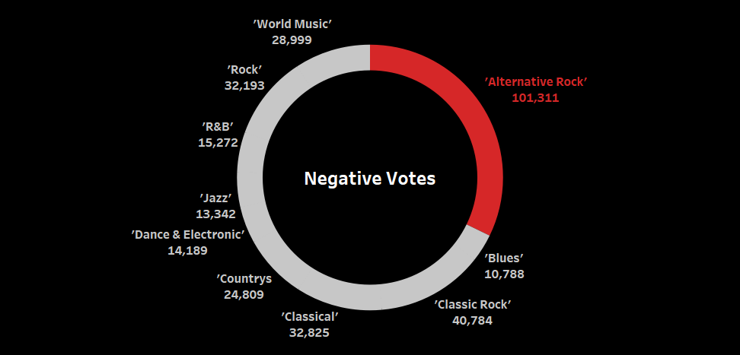
CDs VINYL– Sub Category wise Positive and Negative Votes
10

Slide 17
Time Series Analysis
Time series analysis can uncover hidden trends in customer sentiment from historical data, enabling businesses to make data-driven decisions about marketing, inventory, and customer support by forecasting future sentiment trends for subcategories.
A forecast was made for the period of 2018 to 2022 in Office Products.
SARIMA model was used. As the data contains trend, seasonality, and residual components.
Data available is a time series ranging from 1998 to 2018.
Data was resampled to a monthly frequency.
11

Slide 18
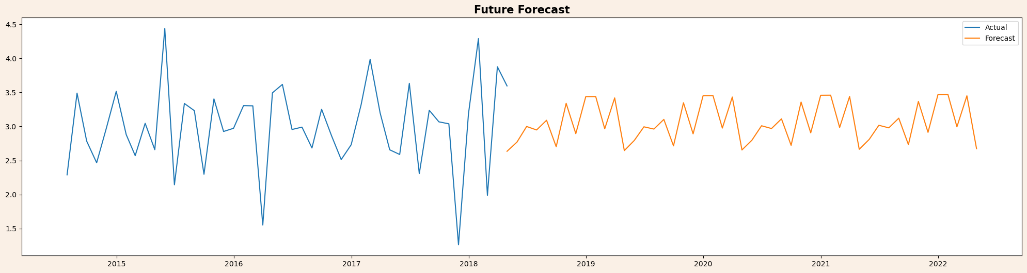
12
Office Products
Forecasting Sentiments
Future Forecast plot shows the predicted values for a specific variable over time . We can see seasonal or cyclical patterns exist in the forecast. By This we can confirm that the Customer Rating Forecast is good which is lying in between 2.5 to 3.5 . Its a Moderate Sentiment we can say. Also the Business sales will slightly increase along with the reputation.

Slide 19
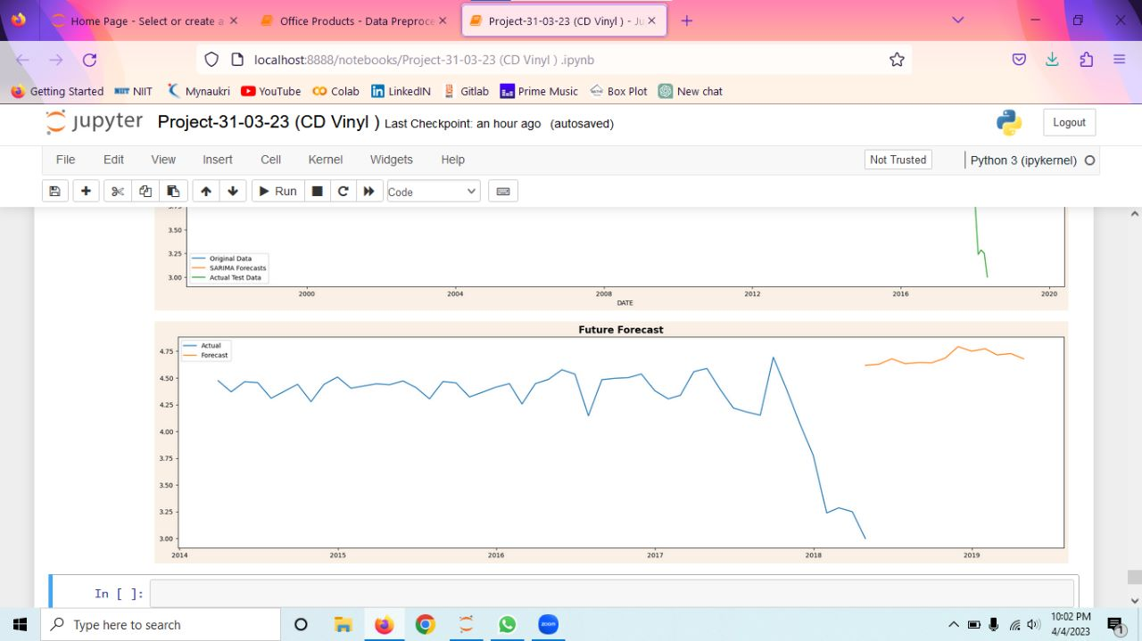
13
CDs Vinyl
Forecasting Sentiments
Future Forecast plot shows the predicted values for a specific variable over time . We can see seasonal or cyclical patterns exist in the forecast. By This we can confirm that the Customer Rating Forecast is good which is lying in between 4.5 to 5 . Its a Good Sentiment we can say. Also the Business sales will increase along with the reputation.
The Customer Demand has been reduced in 2018 due to Lack of Interest in using the CD’s. As New Products came to the Market which helps customers easily can listen songs through Browser and other applications.
After 2018, It's possible that some older people are more interested in listening to music on CDs because it is a format they are more familiar with and may have used throughout their lives.

Slide 20
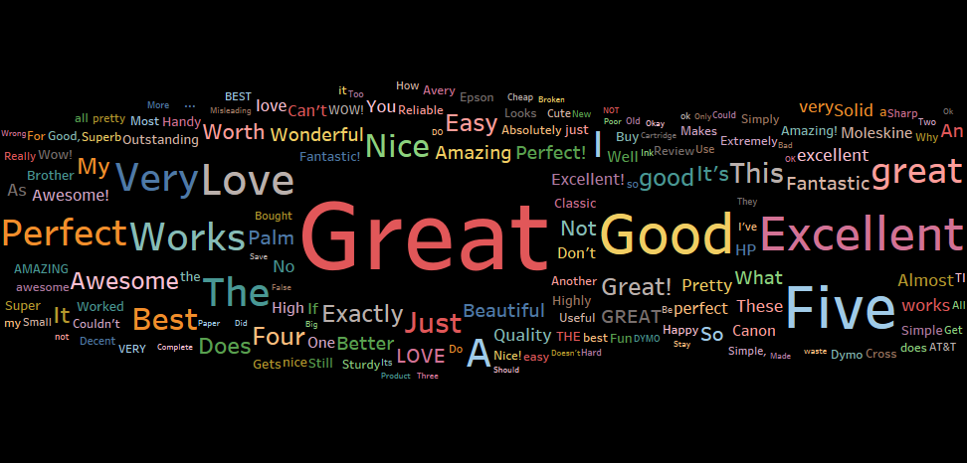


14
EXPLORATORY DATA ANALYSIS ON SENTIMENT
Positive Reviews

Slide 21
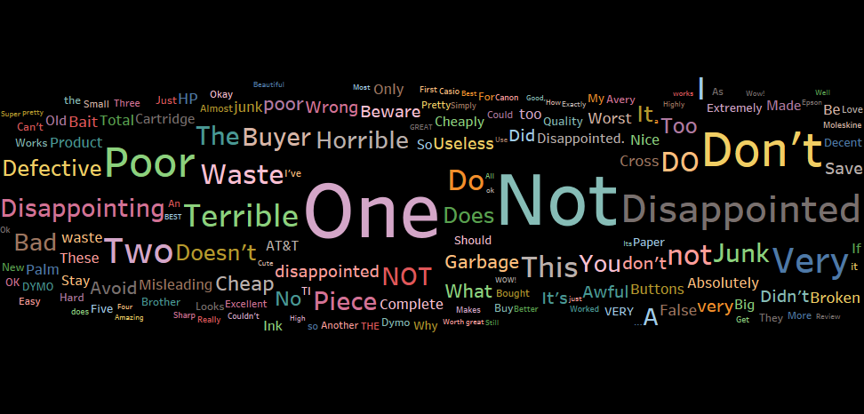

14
EXPLORATORY DATA ANALYSIS ON SENTIMENT
Negative Reviews

Slide 22
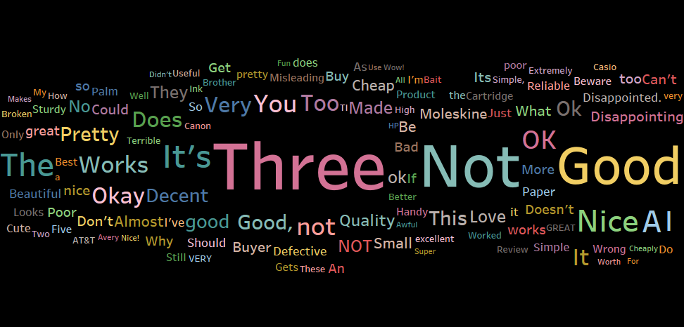
14
EXPLORATORY DATA ANALYSIS ON SENTIMENT
Neutral Reviews

Slide 23
Random Forest Classifier – Best Model
Suggested Model
Model Name | Accuracy
Navie Bayes | 81.72 %
Random Forest | 93.2 %
Decision Tree | 90.69 %
Logistic Regression | 79.45 %
Category
Office Products
More
Efficient
High Accuracy
Score 93.2 %
Easily Handles
Large Datasets
15

Slide 24
Logistic Regression – Best Model
Suggested Model
Model Name | Accuracy
Navie Bayes | 76.52 %
Random Forest | 84.73 %
Decision Tree | 81.23 %
Logistic Regression | 87.4 %
Category
CDs Vinyl
Probability output
High Accuracy
Score 87.4 %
Simplicity
&
Efficiency
16

Slide 25
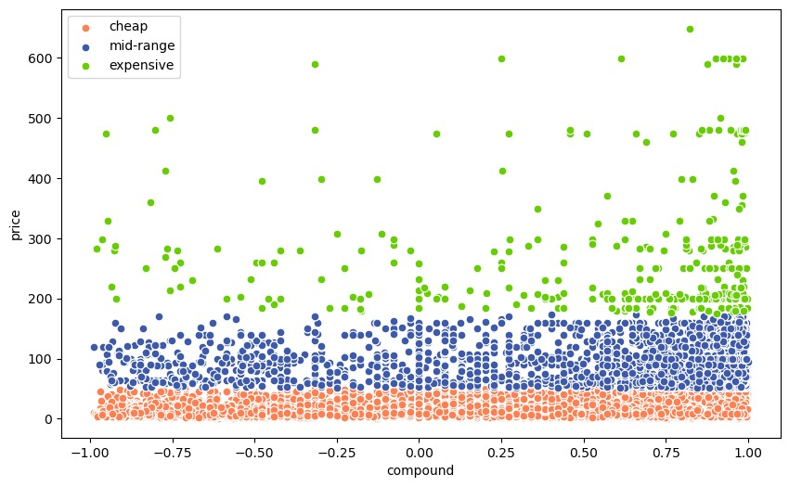
Logistic Regression – Best Model
Suggested Model
Probability output
Simplicity
&
Efficiency
17

Slide 26
KMeans Clustering – Best Model
Suggested Model
Probability output
Simplicity
&
Efficiency
17

Slide 27
Challenges faced in Sentiment Analysis
Sentences can vary widely in length and complexity
Approach: One approach to addressing this challenge is to segment text into smaller, more manageable units, such as clauses or phrases. This can help to identify the key ideas and emotions in a sentence and make sentiment analysis more accurate.
Punctuation and special characters
Approach: To address this challenge, we used text preprocessing techniques such as removing or replacing punctuation and special characters.
17

Slide 28
Challenges faced in Sentiment Analysis
Sentences can vary widely in length and complexity
Approach: One approach to addressing this challenge is to segment text into smaller, more manageable units, such as clauses or phrases. This can help to identify the key ideas and emotions in a sentence and make sentiment analysis more accurate.
Punctuation and special characters
Approach: To address this challenge, we used text preprocessing techniques such as removing or replacing punctuation and special characters.
18

Slide 29
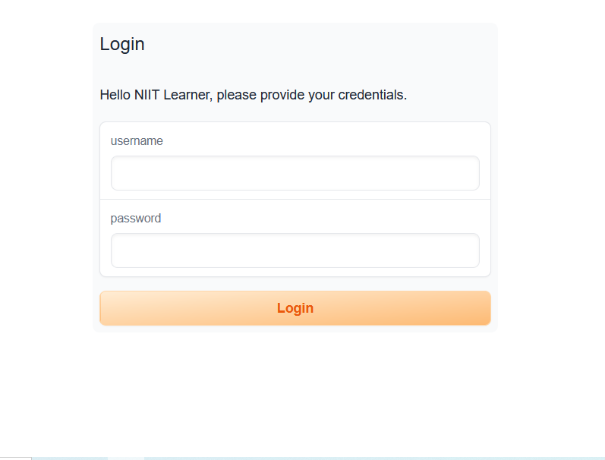
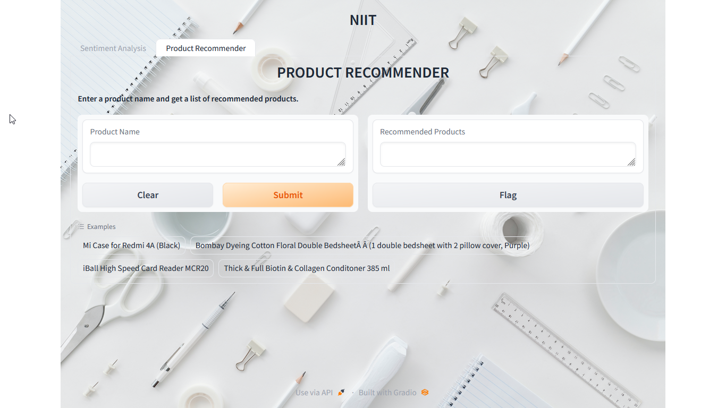
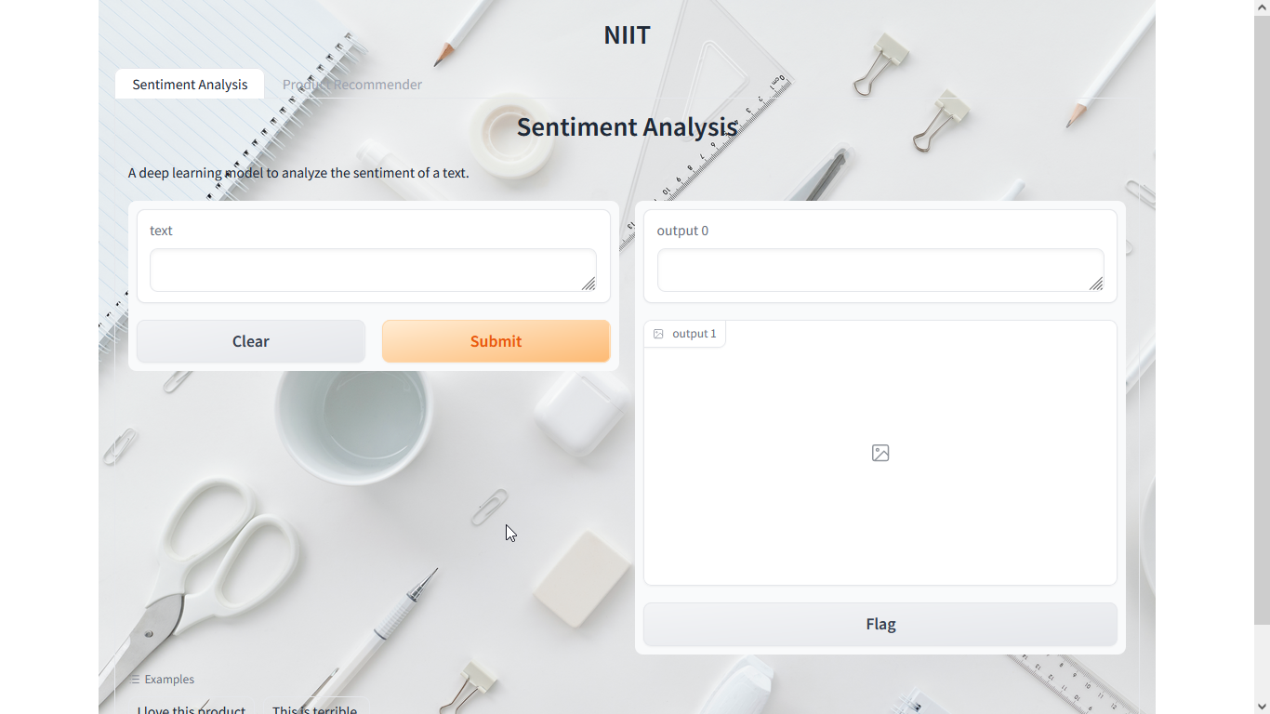
Web Application on Sentiment Analysis & Product recommender
19

Slide 30
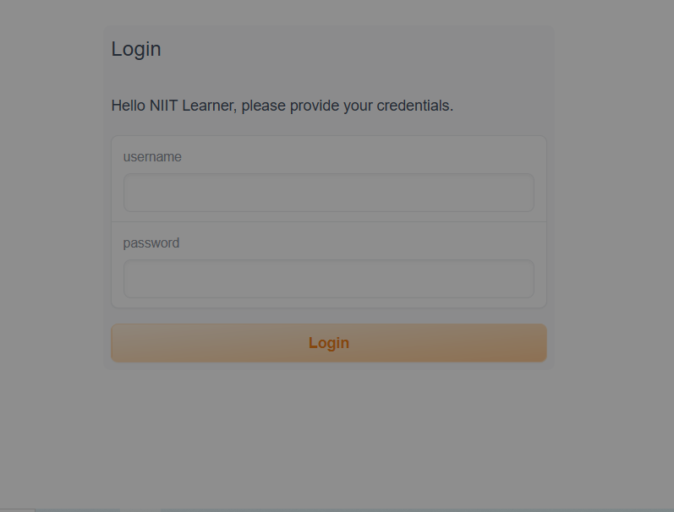
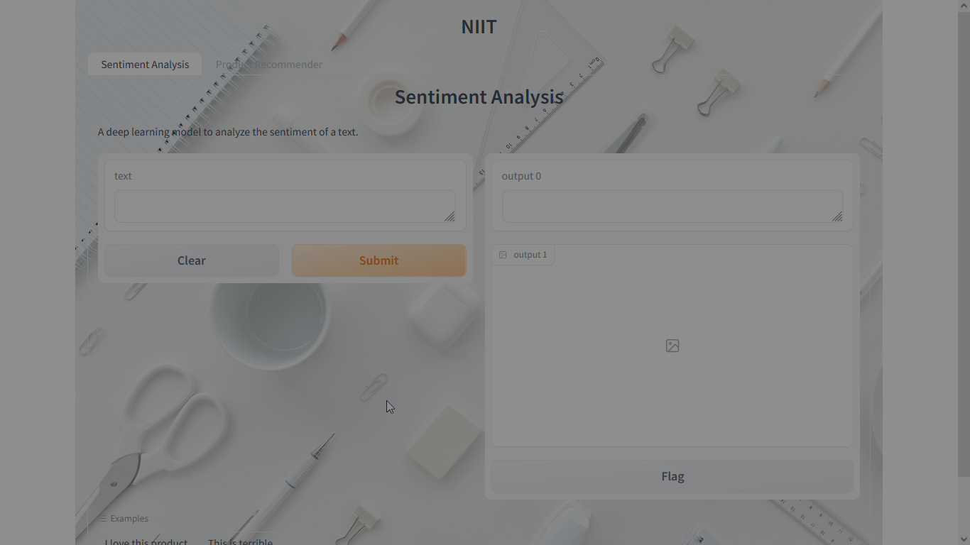
Web Application on Sentiment Analysis & Product recommender
20

Slide 31
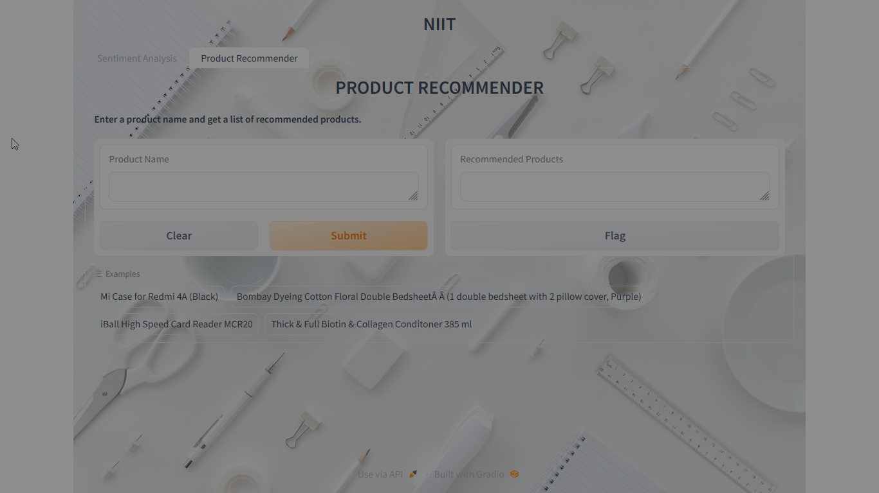
Web Application on Sentiment Analysis & Product recommender
21

Slide 32
Business Insights
Our deployed model has several strengths, including the ability to process review data in real-time .
Deploying a real-time approach to sentiment analysis offers numerous use-cases
(GUI) also enhances the sentiment analysis process, allowing companies to easily categorize reviews as positive, negative, or neutral. This approach can further aid in identifying areas for improvement and help organizations to tailor their products or services to better meet customer needs.
Overall, the deployment of a real-time sentiment analysis approach offers numerous benefits for both organizations and their customers.
22
The deployment of such an approach allows organizations to forecast customer ratings based on previous review data, aiding in the development of effective marketing strategies.

Slide 33
Business Insights
Our deployed model has several strengths, including the ability to process review data in real-time.
Deploying a real-time approach to sentiment analysis offers numerous use-cases
Deploying a real-time approach to sentiment analysis can also benefit customers. Through the GUI, customers can access recommended products facilitating an improved shopping experience
Overall, the deployment of a real-time sentiment analysis approach offers numerous benefits for both organizations and their customers.
The deployment of such an approach allows organizations to forecast customer ratings based on previous review data, aiding in the development of effective marketing strategies.
23

Slide 35
Thank’s

